Slide 1
Networks 3: Classical networks & network processes

Slide 2
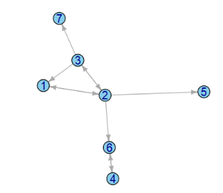
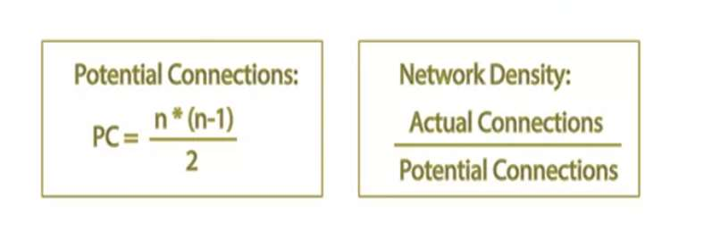
Density
Directed vs undirected networks?

Slide 3
Dyad & Reciprocity
See code example

Slide 4
Triad & Transitivity
See code example

Slide 5
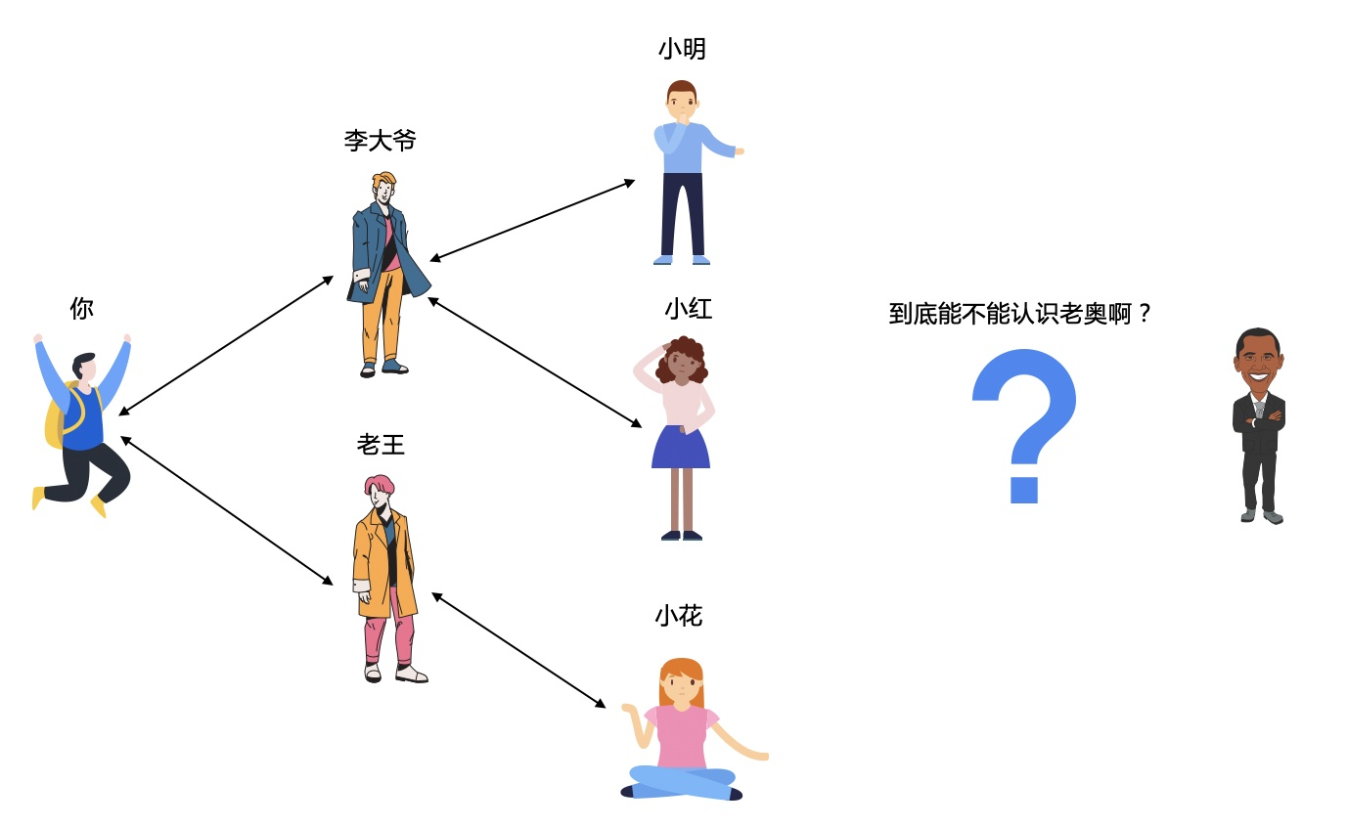
Milgram’s (1969) mall world experiment: Six degrees of separation

Slide 6
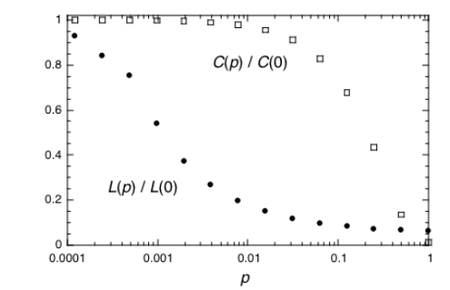
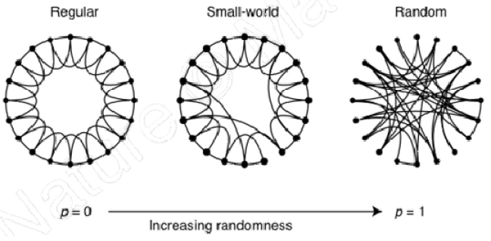
Small world networks
Paradox: Individuals within the network are highly clustered but also have small average geodesics to other members
Randomly rewiring a fraction of links on a regularly-clustered network drastically shortens average eccentricity, but clustering remains high.
Watts, D., Strogatz, S. Collective dynamics of ‘small-world’ networks. Nature 393, 440–442 (1998).

